Slide 1
Compressive Sensing
Physics 305

Slide 2
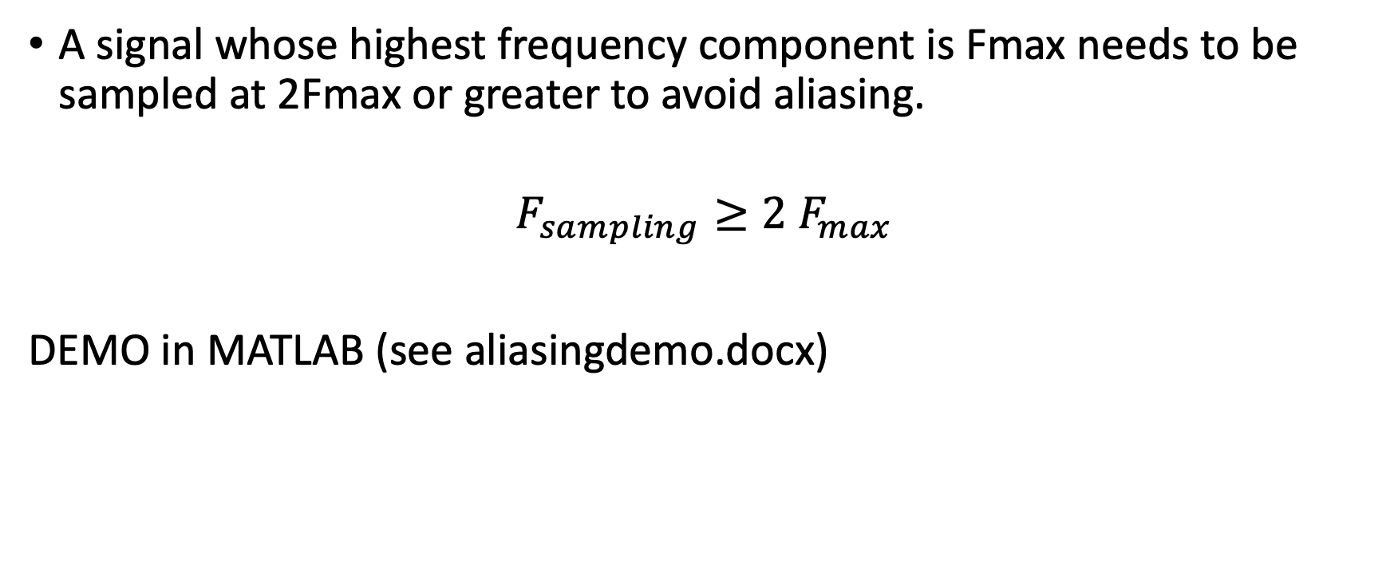
Shannon-Nyquist Theorem
A signal whose highest frequency component is Fmax needs to be sampled at 2Fmax or greater to avoid aliasing.
$$F_{sampling}≥2 F_{max}$$
DEMO in MATLAB (see aliasingdemo.docx)

Slide 3
IT turns out…
Shannon-Nyquist Theorem only holds true if the signal is evenly sampled.
If the signal is randomly sampled, we can get away with sampling the signal much lesser.
Compressive Sensing is the process by which we can recover the signal through random and fewer sampling.
Relatively new technique - ~ 17 years old

Slide 4
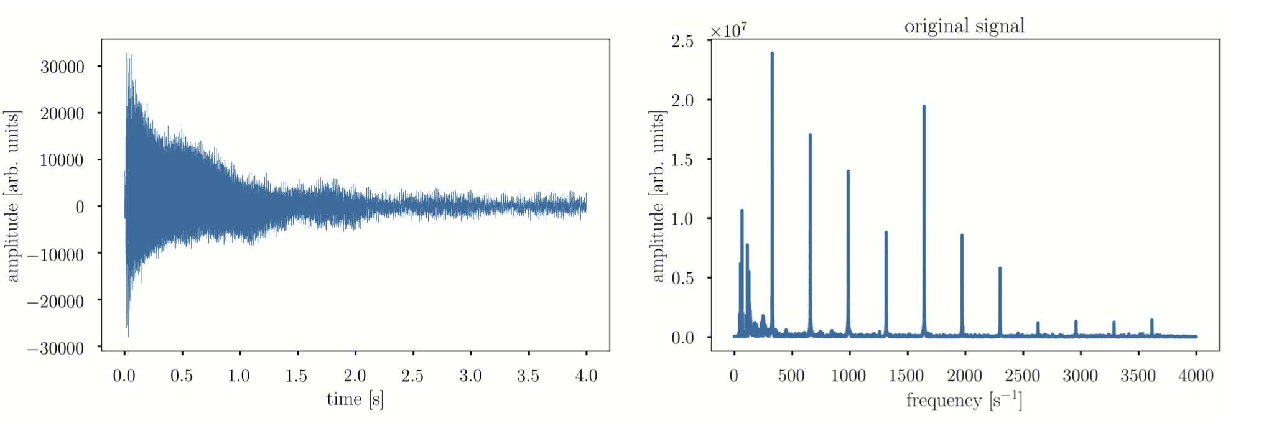
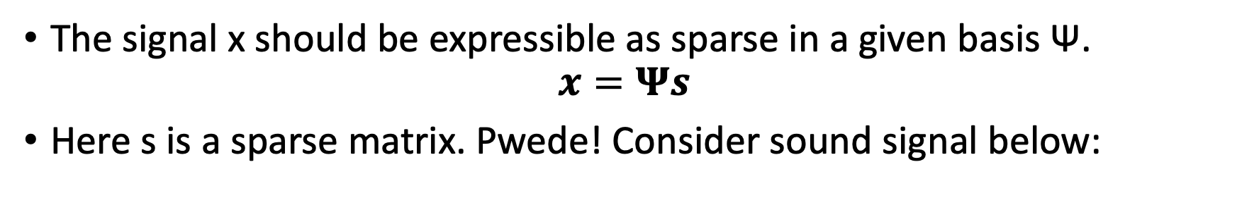
Requirement
The signal x should be expressible as sparse in a given basis Ѱ.
$$x=Ψs$$
Here s is a sparse matrix. Pwede! Consider sound signal below:
Plots from Ref. 3

Slide 5
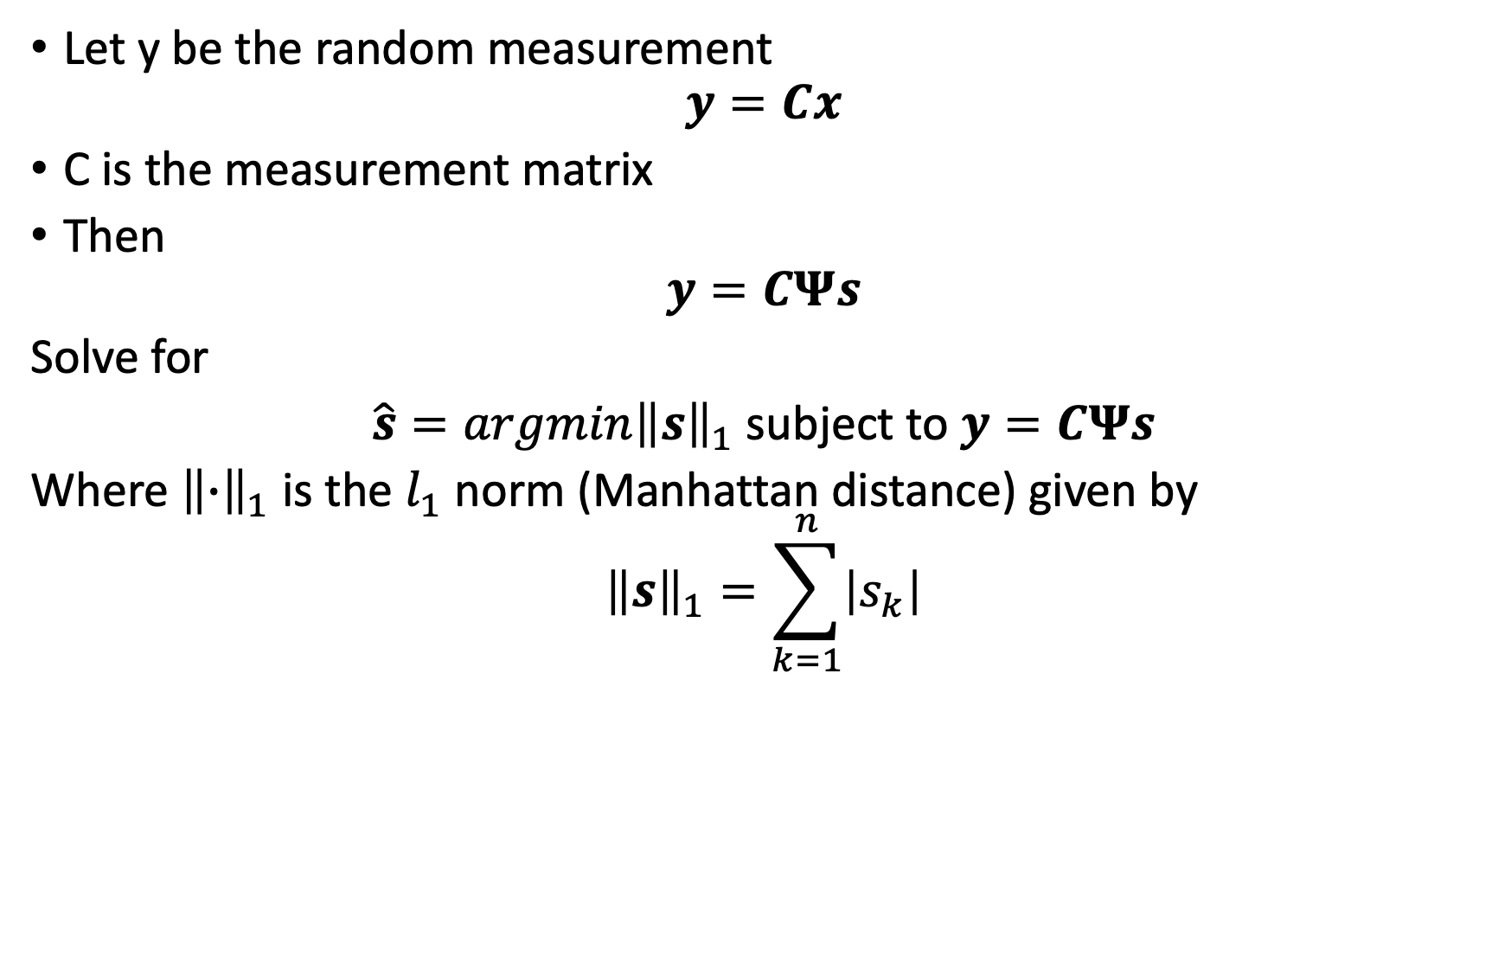
Compressive Sensing
Let y be the random measurement
$$y=Cx$$
C is the measurement matrix
Then
$$y=CΨs$$
Solve for
$\hat{s}=argmin{\left\|s\right\|}_{1}$subject to $y=CΨs$
Where ${\left\|∙\right\|}_{1}$ is the $l_{1}$ norm (Manhattan distance) given by
$${\left\|s\right\|}_{1}=\sum_{k=1}^{n}{\left|s_{k}\right|}$$

Slide 6
How to solve
ConVeX (cvx) optimization package
CoSaMP - Compressed Sensing Matching Pursuit
LASSO –Least Absolute Shrinkage and Selection Operator
OMP – Orthogonal Matching Pursuit

Slide 7
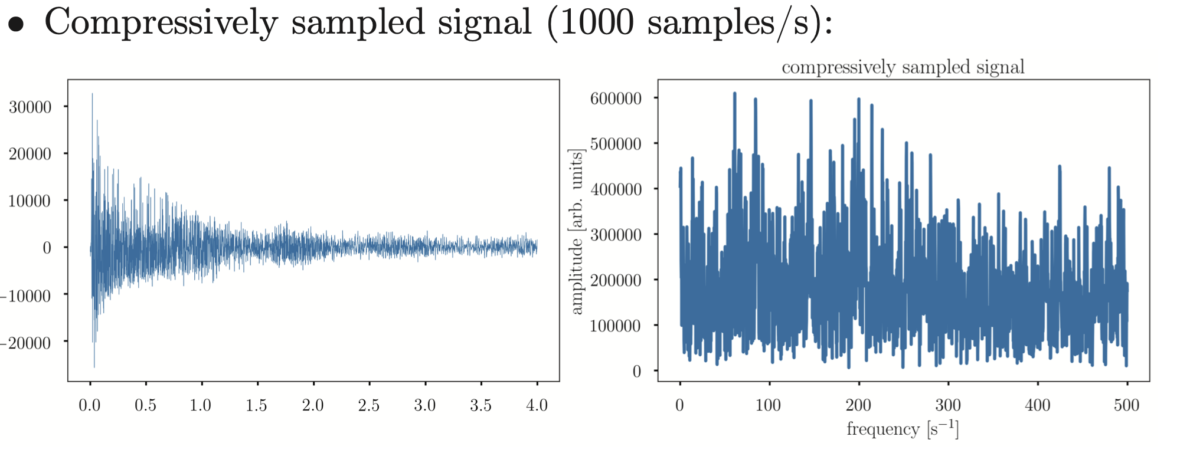
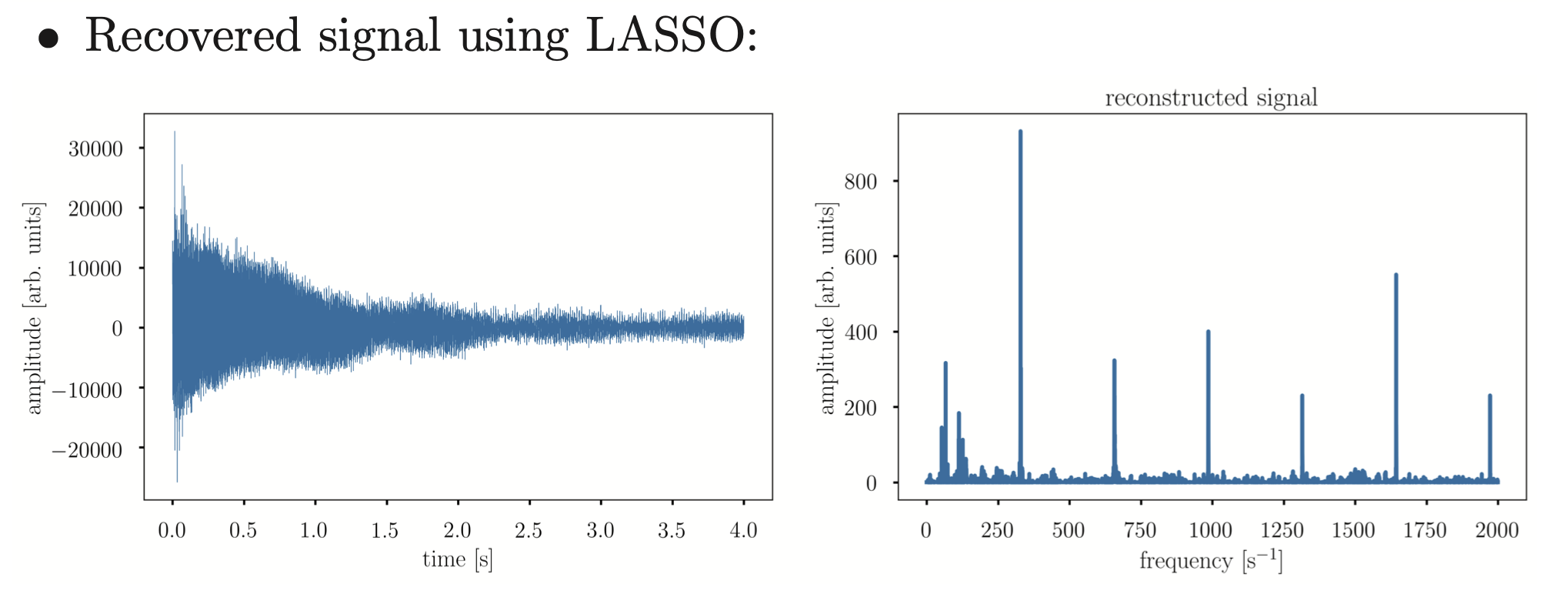
Example
Plots from Ref. 3

Slide 8
Reference
S. Brunton, J. Kutz, “Data-driven science and engineering”, Chapter 3 (2019) Cambridge University Press
https://youtube.com/playlist?list=PLVnEmTOBCgy0QFxU5kKNFOy1CIwCieSDl
KV Domingo and MN Soriano, Frequency domain reconstruction of stochastically sampled signals based on compressive sensing, Proceedings of the Samahang Pisika ng Pilipinas 37, SPP-2019-PB-38 (2019). URL: https://proceedings.spp-online.org/article/view/SPP-2019-PB-38
KV Domingo and MN Soriano, Compressively sampled speech: How good is the recovery?, Proceedings of the Samahang Pisika ng Pilipinas 38, SPP-2020-4C-04 (2020). URL: https://proceedings.spp-online.org/article/view/SPP-2020-4C-04.

